Slide 1
Lecture 1.4 - Learning Goals and Expectations
DLI Accelerated Data Science Teaching Kit

Slide 2

The Accelerated Data Science Teaching Kit is licensed by NVIDIA, Georgia Institute of Technology, and Prairie View A&M University under the
Creative Commons Attribution-NonCommercial 4.0 International License.

Slide 3
Learning Goals

Slide 4
Topics Covered

Slide 6
“Caveats” for Students
Learning data science can involve a lot of programming
You need to be prepared to learn many things in short amount of time, e.g., visualization, JavaScript, CSS, Scala
Very common in industry

Slide 7
From Previous Offerings …
The course materials of CSE 6242 Data and Visual Analytics at Georgia Tech are based on this teaching kit
Class projects had turned into research publications, e.g., KDD, IUI
Projects as portfolio pieces on CV
Increased job and internship opportunities
Receive numerous “thank you” notes from former students

Slide 8
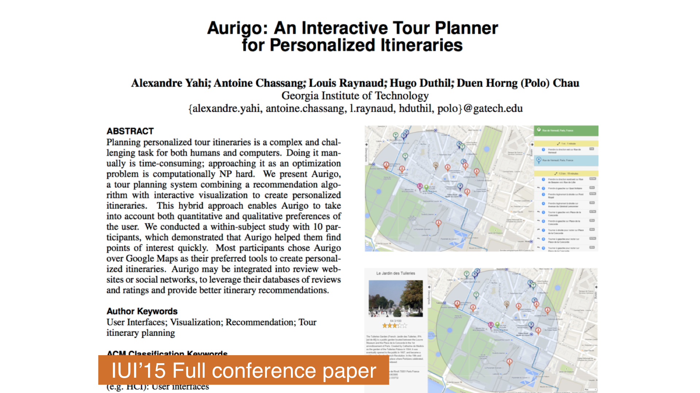

Slide 9
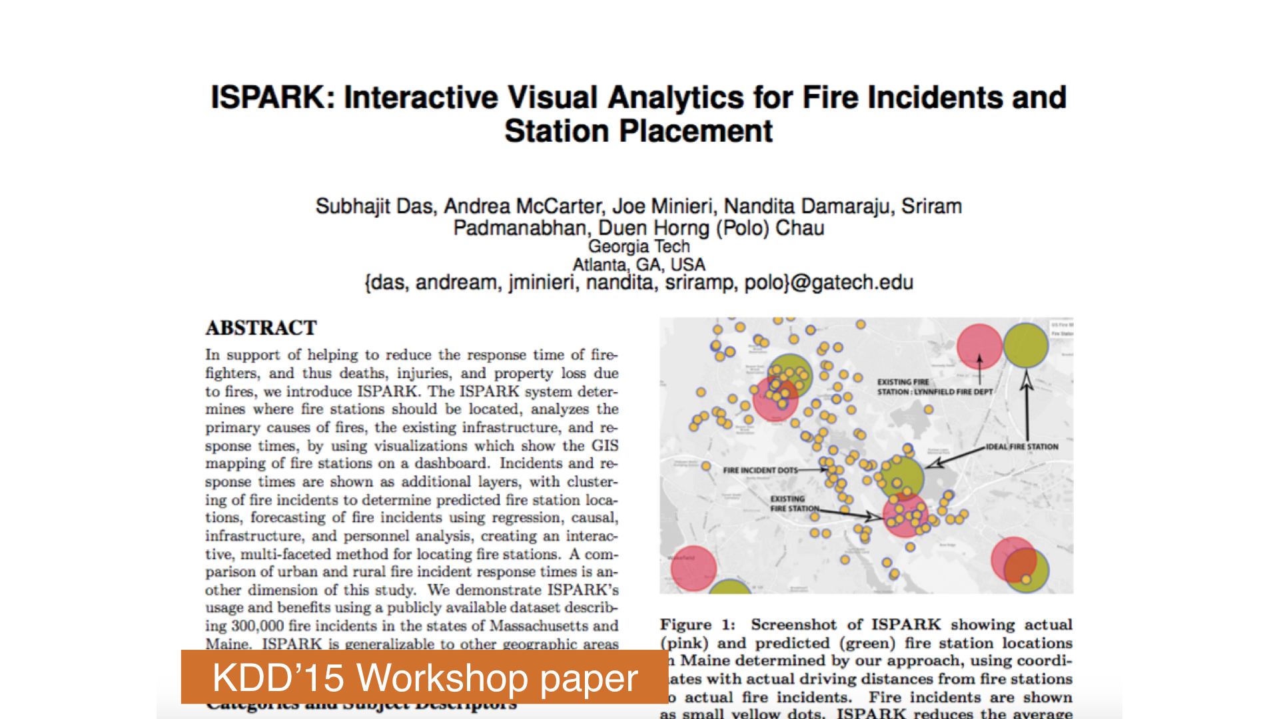

Slide 10
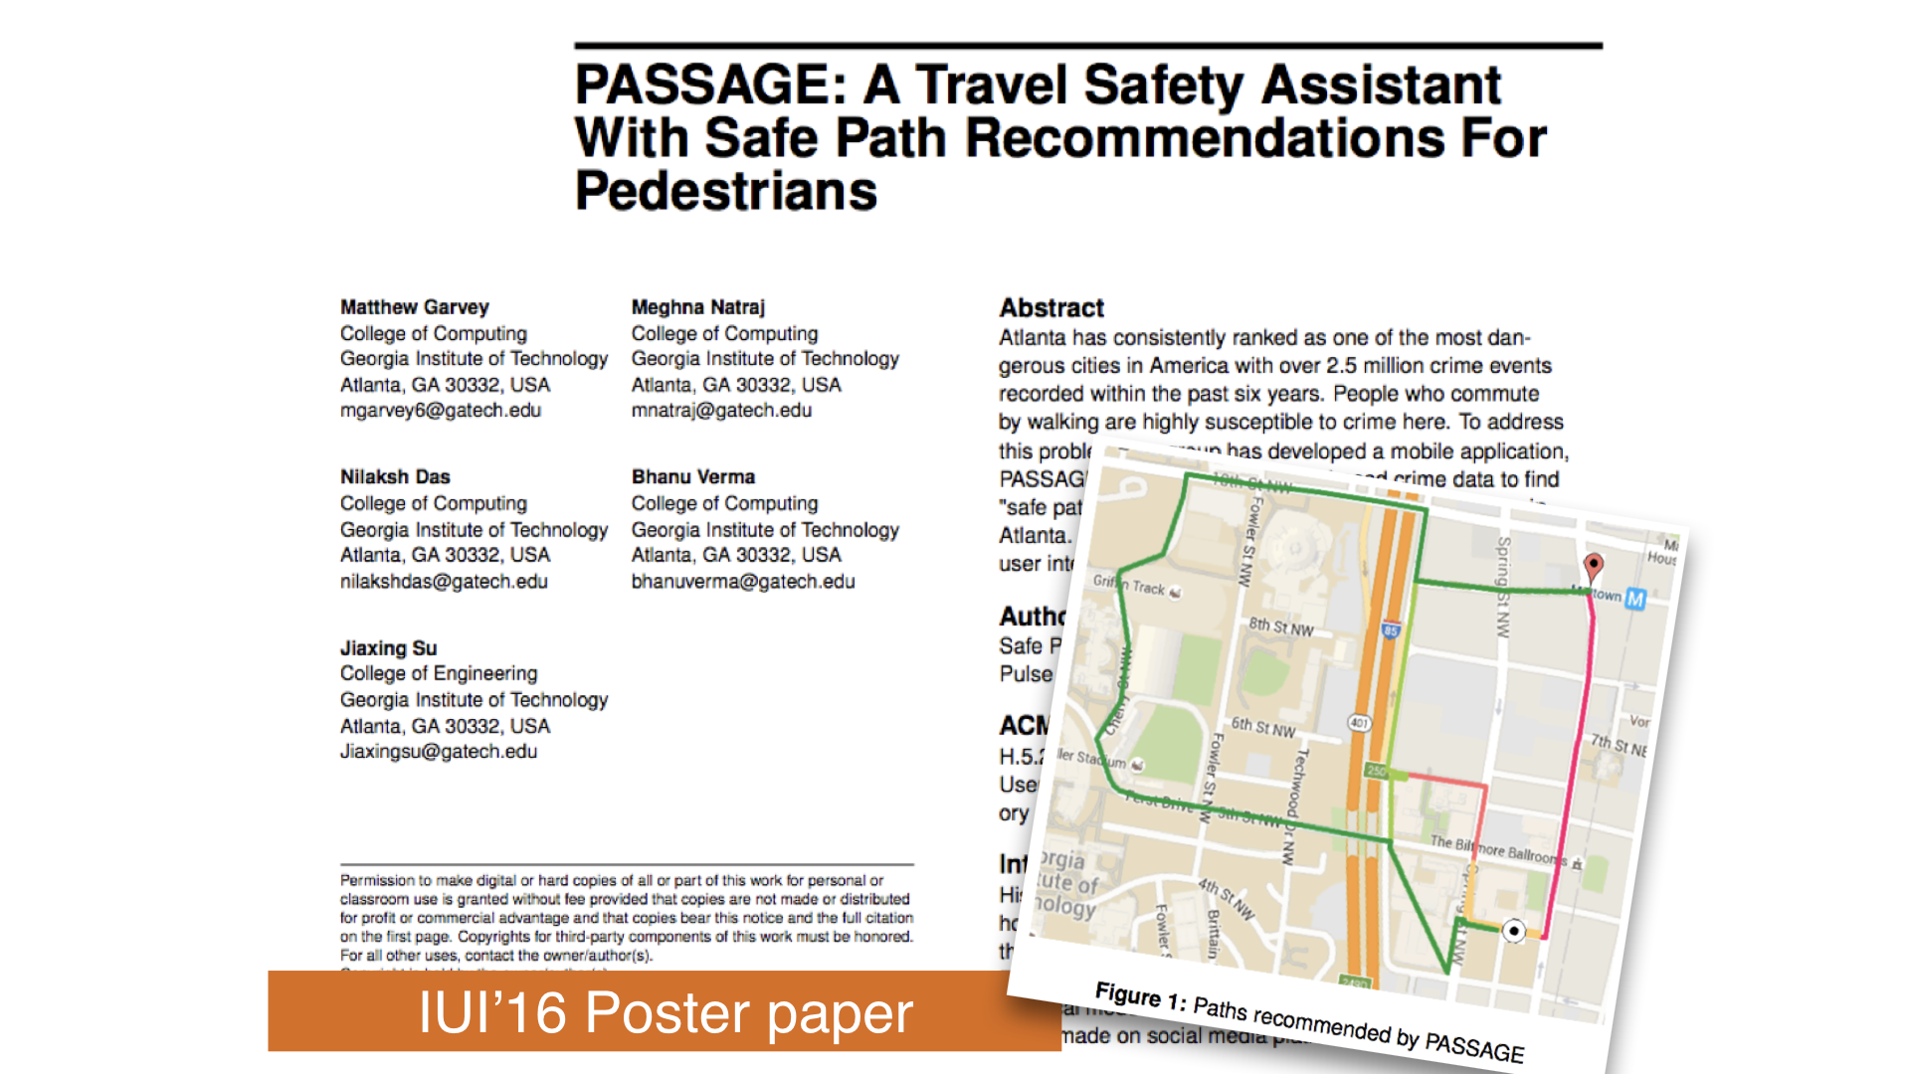

Slide 11
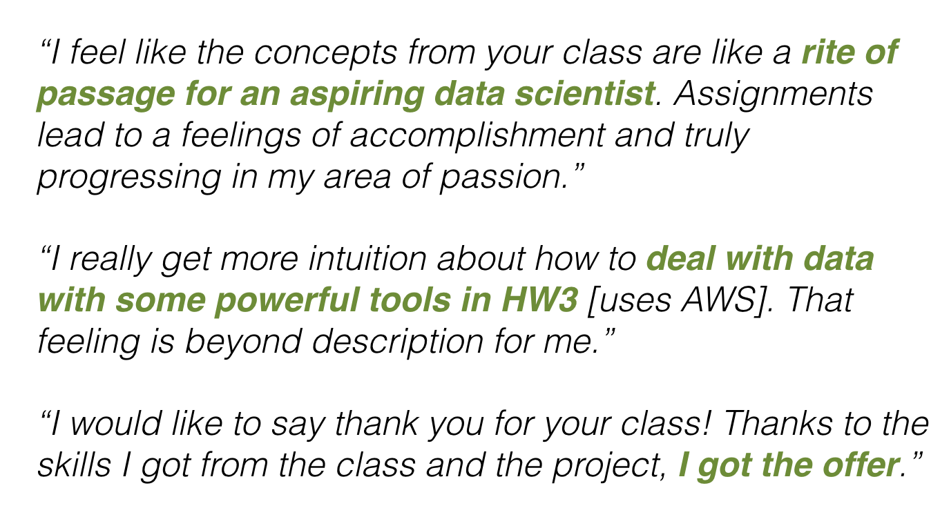
Student Reflections

Slide 12
DLI Accelerated Data Science Teaching Kit
Thank You

